Slide 1


Autonomic Nervous System
Dr. Mascara Ghassan
Physiology Department
College of Medicine\ University of Basrah

Slide 2
Objectives
After studying this lecture, you should be able to:
Describe the organisation of the autonomic nervous system.
List the differences between the efferent somatic & autonomic nerves
List the anatomical divisions of the ANS
Describe the location of the cell bodies and axonal trajectories of preganglionic and postganglionic sympathetic., and parasympathetic neurons
Name the neurotransmitters
Name the receptors and their types.

Slide 3
Nervous System
Central nervous system
Peripheral nervous system
V
Brain spinal cord
Somatic Autonomic
Sensory Motor
Sympathetic parasympathetic

Slide 4
Autonomic Nervous System
A.N.S. controls the involuntary functions which are not under our will &so controlled automatically & reflexly.
It is the part of the nervous system that is responsible for homeostasis (maintenance of nearly constant conditions in the internal environment).
Innervation to all other organs is supplied by the ANS
Except for skeletal muscle, which gets its innervation from the somatomotor nervous system.

Slide 5
ANS Divisions
Sympathetic &parasympathetic pathways These two pathways are antagonistic in their effects (if one excites, the other will inhibit).
And Enteric N. S (functioning within the GIT)

Slide 6
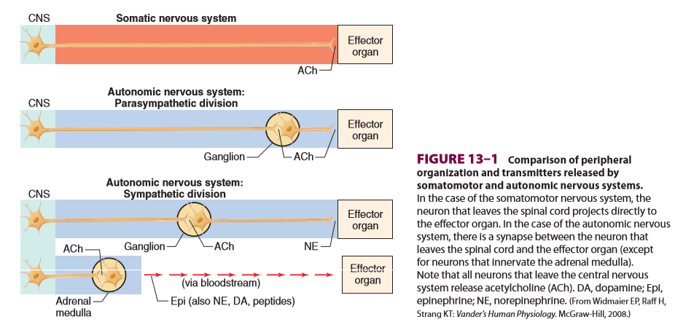

Slide 7
Differences between the efferent somatic & autonomic nerves are the following:
Final common pathway
Somatic nerves
Autonomic nerves
Sympathetic, parasympathetic
α-motor neuron,
Preganglionic, postganglionic

Slide 8
Fiber types
Somatic nerves
Autonomic nerves
preganglionic axons are small-diameter, myelinated, relatively slowly conducting B fibers.
Large diameter rapidly conducting, α-motor neuron.
postganglionic axons neurons are mostly unmyelinated C fibers

Slide 9
One Similar feature
Acetylcholine

Slide 10
The ANS acts within a reflex arc:
A receptor (glands, muscles) → Afferent n. → integration in the C.N.S → Efferent n. → effector. (muscle, glands).

Slide 11
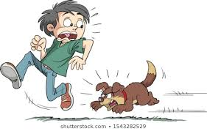

Sympathetic NS Fight or Flight
Parasympathetic NS
Rest and Digest

Slide 12
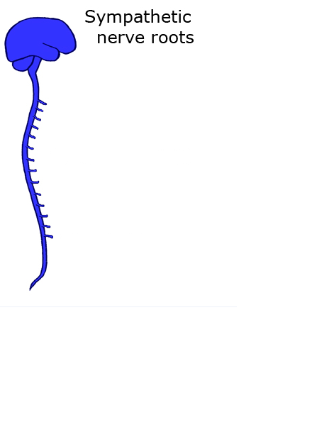
Thoracic segments T1-T12
Lumbar segments L1-L2

Slide 13
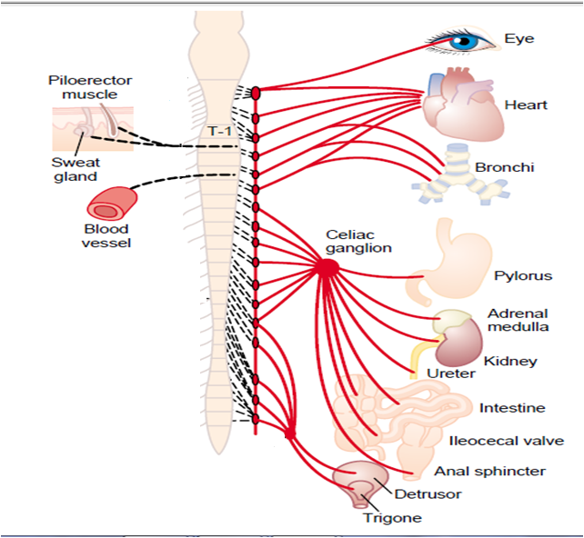

Slide 14
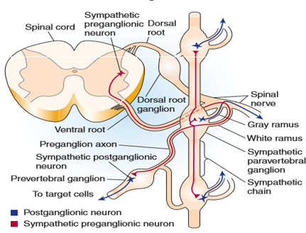

Slide 15
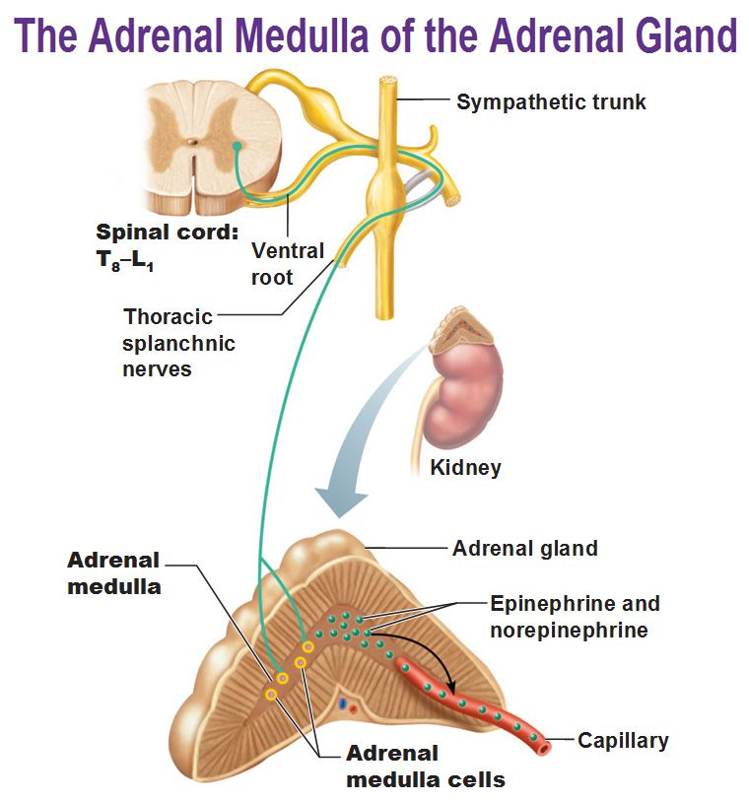

Slide 16
Adrenal Medulla
It is sympathetic ganglia in which the postganglionic cells that secrete catecholamine (epinephrine, nor epinephrine& dopamine) directly into the blood.

Slide 17
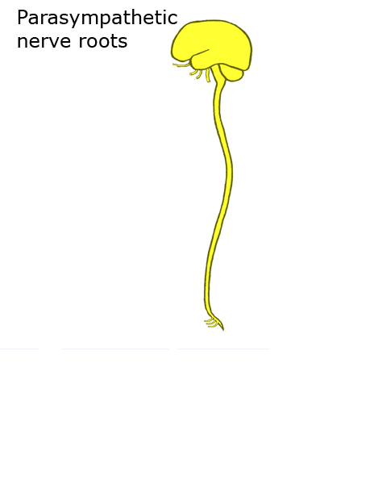
III, VII, IX,
X
S2, S3, S4

Slide 18
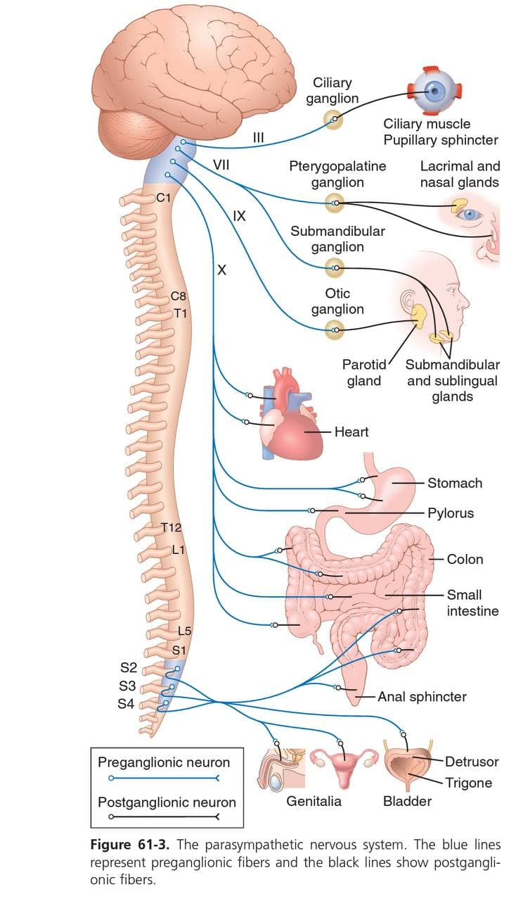

Slide 19
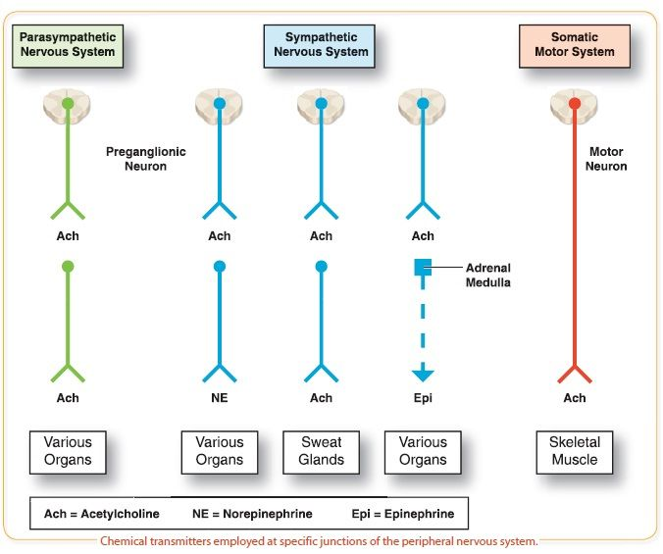
Chemical transmission at autonomic junctions

Slide 20
Chemical divisions of the A.N.S
1. According to the type of neurotransmitter secreted:
A. Cholinergic division: secret Ach.
B. Adrenergic division: secret Norepinephrine

Slide 21
The autonomic neurons that are cholinergic are:
(1) All preganglionic neurons
(2) All parasympathetic postganglionic neurons
(3) Sympathetic postganglionic neurons that innervate sweat glands
(4) Sympathetic postganglionic neurons that end on blood vessels in some skeletal muscles and produce vasodilation when stimulated (sympathetic vasodilator nerves).

Slide 22
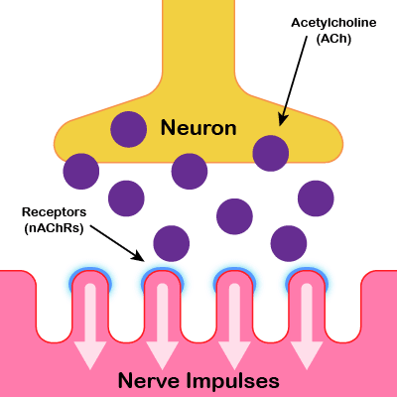

Slide 23
After secretion of NE, it is removed by:
1. Reuptake into the nerve endings (50-80%)
2. Diffusion into the surrounding body fluids & then to the blood.
3. Destruction by enzymes (monoamine oxidase), & (catechol-O- methyltransferase.
There is usually no Ach. In the circulation.
NE secreted by the nerve endings remains active for a few sec.
NE &E secreted by the adrenal medulla remain active until they diffuse into some tissues where they are destroyed by COMT. , So NE &E remain active for 10-30 sec.

Slide 24
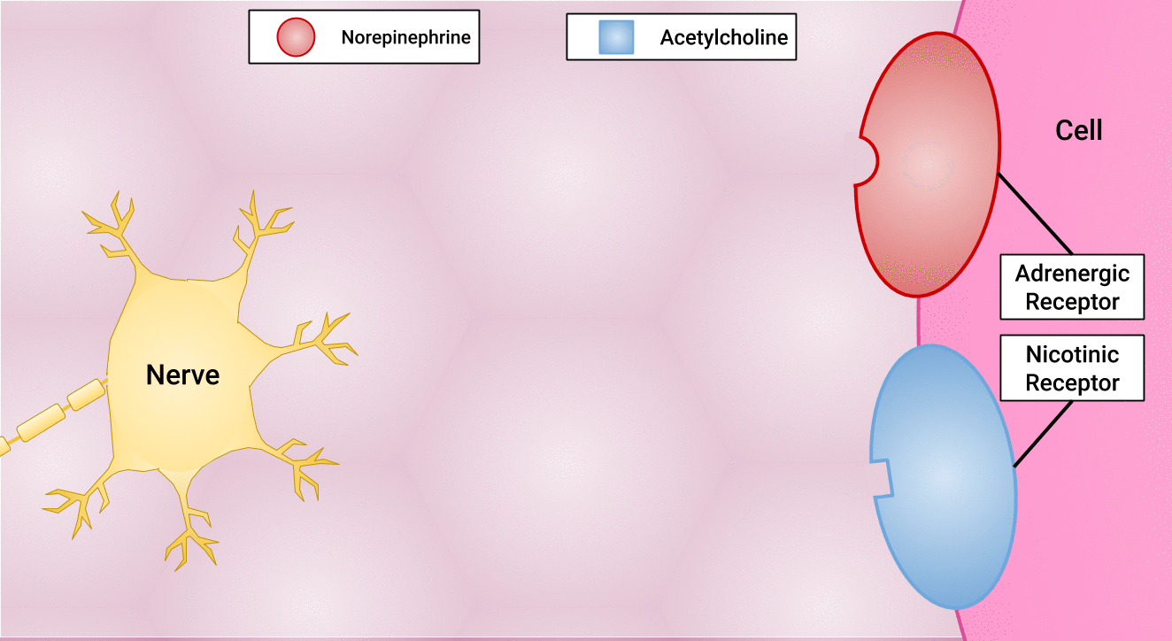
Receptors on the effector organs

Slide 25
Types of receptors
1. Cholinergic receptors: which are stimulated by Ach. :
A. Nicotinic receptor
B. Muscarinic receptor
2. Adrenergic receptor:
Alpha receptor: alpha₁ & alpha₂
B. Beta receptor: beta₁ , beta₂ &beta₃
Epinephrine excites both types of receptors approximately equally.

Slide 26
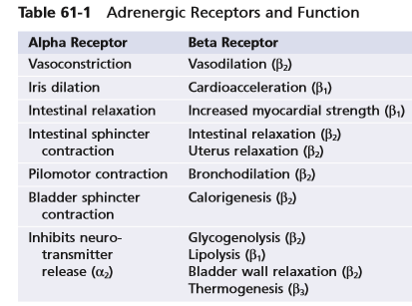
Certain alpha functions are excitatory, whereas others are inhibitory. Likewise, certain beta functions are excitatory and others are inhibitory as shown in the following table:

Slide 27
Norepinephrine excites mainly alpha receptors but excites the beta receptors to a lesser extent as well.
Epinephrine excites both types of receptors approximately equally.

Slide 28
Recap
A.N.S. controls the involuntary functions which are not under our will.
Sympathetic, parasympathetic divisions
The final common pathway linking the central nervous system (CNS) to skeletal muscles is the α-motor neuron, while sympathetic and parasympathetic neurons serve as the final common pathway from the CNS to visceral targets.
Somatic nerves are large diameter and rapidly conducting α-motor neurons, preganglionic axons are small-diameter, myelinated, slowly conducting B fibers, The axons of the postganglionic neurons are mostly unmyelinated C fibers and terminate on the visceral effectors.
Sympathetic nerves(thoracolumbar)pathway.
6. Cranial and sacral divisions of parasympathetic preganglionic neurons
7. Types of transmitters released as well as type of receptors .

Slide 29
Thank You

